Slide 1
Combination Code and Task Profile Procedures

Slide 2
This document is intended to assist you with the combination code load process and task profile additions.

Slide 3
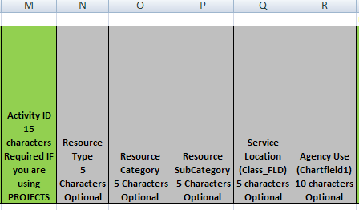
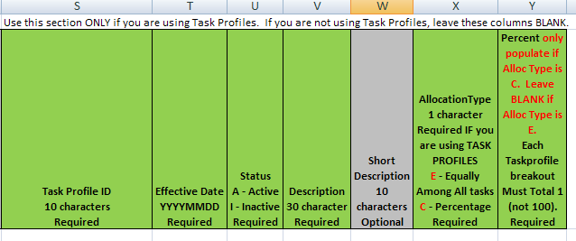
Adding a New Combination Code
Fill out the INF46 Spreadsheet (sample layout below).
When filling out fields for the combination code, the following columns are required:
A, B, C, D, F, G, H, I, J. If you are using project costing, columns K, L, and M are also required.
**Make sure the date is formatted correctly. YYYYMMDD: 20110626
When adding a task profile, the following columns are required:
S, T, U, V, X, and Y.

Slide 4
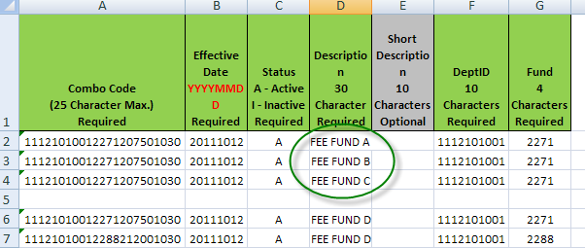
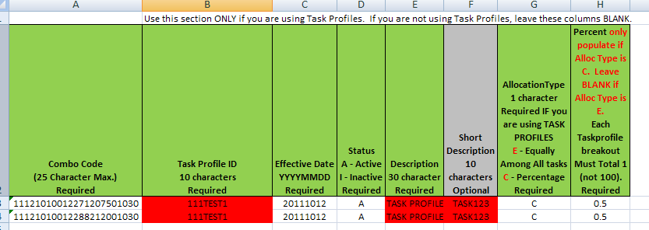
Adding a New Combination Code
Rules:
When adding a combination code and attaching it to multiple profiles, you must keep the description and short description the same for every line that the combination code is used on. Rows 2-4 show an invalid entry. Each line must be the same. Lines 6-7 shows a valid entry.
When adding a new code, keep in mind that anytime any of the ChartFields change, you have to set up a new, unique combo code. You cannot modify a combo code that already exists.
When you have a profile split among several combination codes, you must keep the description and short description the same for every line that the task profile is used.

Slide 5
Adding a New Task Profile
TIPS
Using the INF46 load, enter the appropriate task profile information in columns S-Y, making sure to include the appropriate combo code chartfield information in columns A-R.
If you attach the same funding string to multiple profiles, make sure that the Description and Short Description fields (columns D and E) are identical for every line.
If you are splitting a task profile among several different combination codes, be sure that the Description and Short Description fields (columns V and W) of the task profile are identical for every line.
Make sure that the percent on your task profile totals to 1.

Slide 6
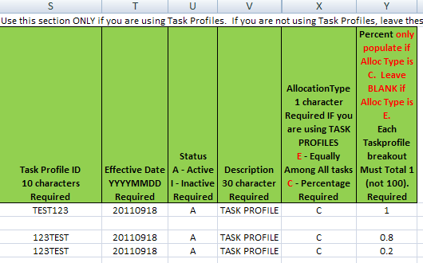
Task Profile Addition
Fill out the INF46 as you would for adding a combination code: (these screen prints only show a portion of the load file )
To add a task profile to the funding strings above, also fill out columns S-Y.
For task profile TEST123, all charges will be charged to the one combination code. For task profile 123TEST, the charges will be 80% to 11100000015678567856789 and 20% to 11100000021234222212222.

Slide 7
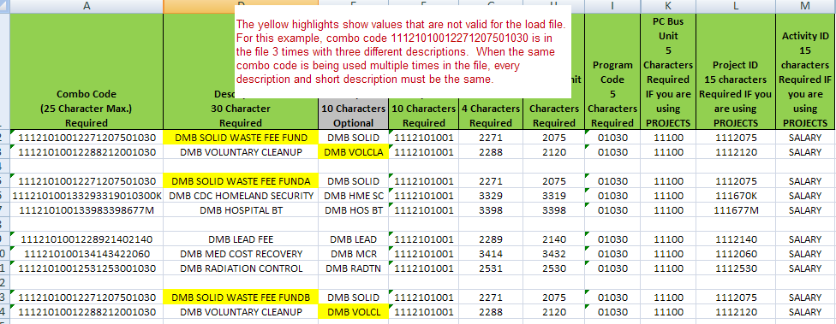
Task Profile Addition Examples

Slide 8
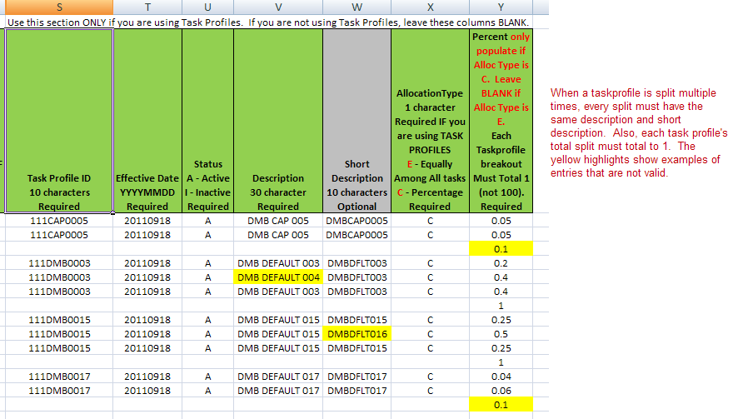
Task Profile

